Slide 1

KEY TERMINOLOGY IN SNOWFLAKE

Slide 2
What is warehouse
A warehouse is a central repository of information that can be analyzed to make more informed decisions. Data flows into a data warehouse from transactional systems, relational databases, and other sources, typically on a regular cadence.
Warehouse is like a hub which contain all your database.
Warehouses are required for queries, as well as all DML operations, including loading data into tables.
Warehouses can be started and stopped at any time. They can also be resized at any time, even while running, to accommodate the need for more or less compute resources, based on the type of operations being performed by the warehouse.

Slide 3
A warehouse provides the required resources, such as CPU, memory, and temporary storage, to perform the following operations in a Snowflake.

Slide 4
What is database
A database is a collection of data that is organized, which is also called structured data. It can be accessed or stored in a computer system.
Each database consists of one or more schemas, which are logical groupings of database objects, such as tables and views.
There are different kinds of databases:
Relational Database:
A relational database is made up of a set of tables with data that fits into a predefined category.
Distributed Database:
A distributed database is a database in which portions of the database are stored in multiple physical locations, and in which processing is dispersed or replicated among different points in a network.

Slide 5
Cloud Database:
A cloud database is a database that typically runs on a cloud computing platform. Database service provides access to the database .
A Snowflake database is where an organization's uploaded structured and semi structured data sets are held for processing and analysis.
Snowflake automatically manages all parts of the data storage process, including organization, structure, metadata, file size, compression, and statistics.

Slide 6
What is schema
A schema is a collection of database objects like tables, triggers, stored procedures, etc. A schema is connected with a user which is known as the schema owner.
A schema is a logical grouping of database objects (tables, views, etc.). Each schema belongs to a single database.
Databases and schemas are used to organize data stored in Snowflake.

Slide 7
What is views
A view is a subset of a database that is generated from a user query and gets stored as a permanent object.
Views serve a variety of purposes, including combining, segregating, and protecting data.
A view is a virtual table whose contents are defined by a query.

Slide 8
What is table
Tables are database objects that contain all the data in a database.
In tables, data is logically organized in a row-and-column format similar to a spreadsheet. Each row represents a unique record, and each column represents a field in the record.

Slide 9
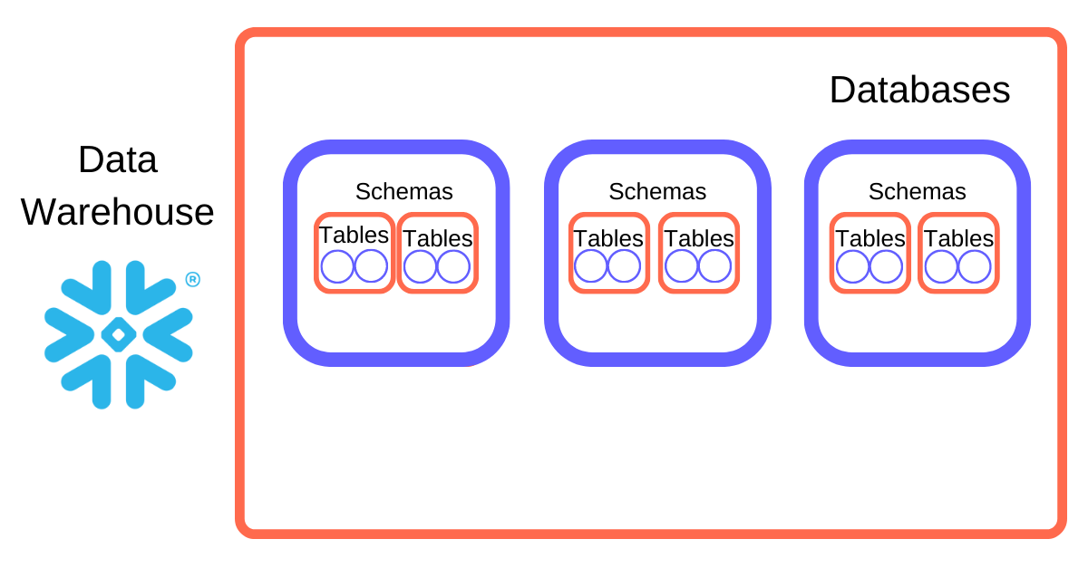

Slide 10
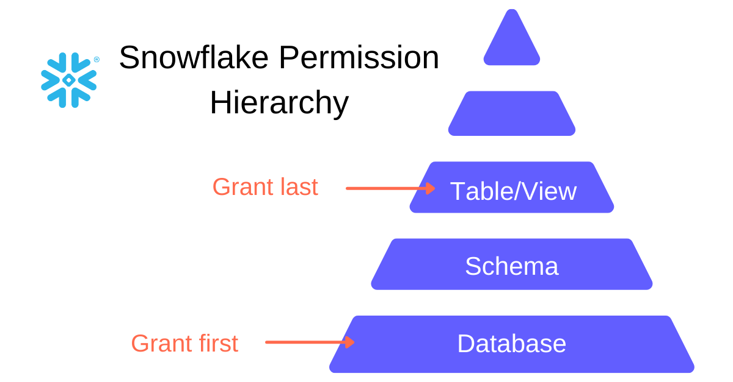

Slide 11
THANK YOU

